Slide 1

Sandes-A Chat Application
18BECE30074
18BECE30167
18BECE30091
Guided By:
Mrs. Jayana Kaneriya

Slide 2
Abstract
Our Project “Sandes-A Chat Application” as the name suggest is chatting based application through which different user can interact with each other.
The sole aim of making this project is to learn more about android and getting more familiar with different aspects of android development.
In this project we also have used GOOGLE FIREBASE which is a very important feature when it comes to data storage and various other services for development
In this app users will be able to send messages to each other and can set up their profile. This app features an OTP based authentication through which the user can register on the app.

Slide 3
Technologies used in this project
Android
Java
Firebase

Slide 4
System Design

Slide 5
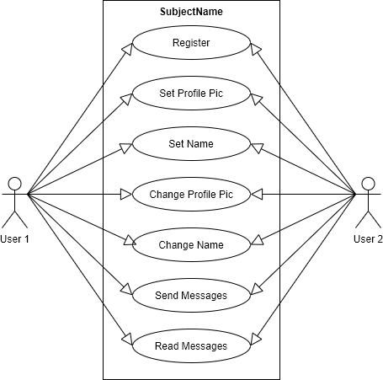
Use Case Diagram

Slide 6
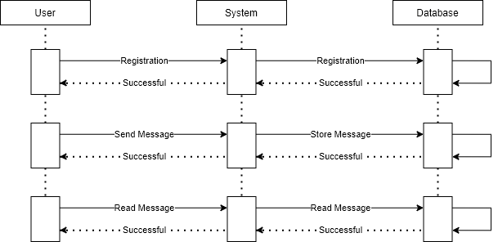
Sequence Diagram

Slide 7
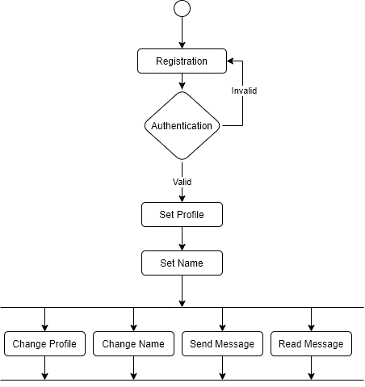
Activity Diagram

Slide 8
App Workflow

Slide 9
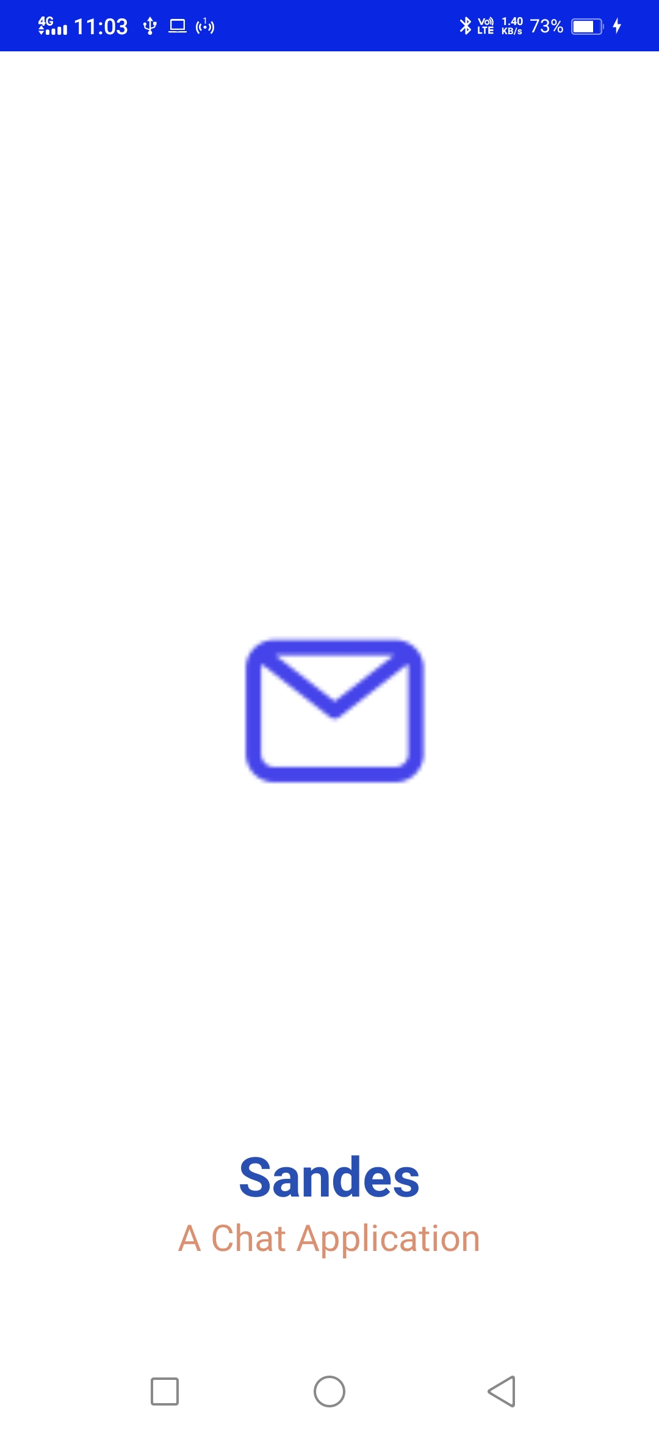
Splash Screen

Slide 10
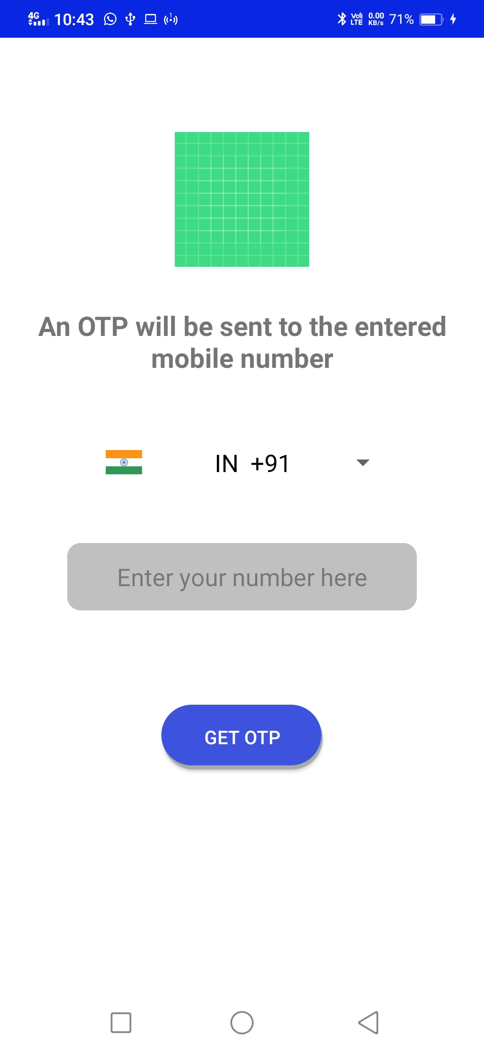
Enter user Mobile Number

Slide 11
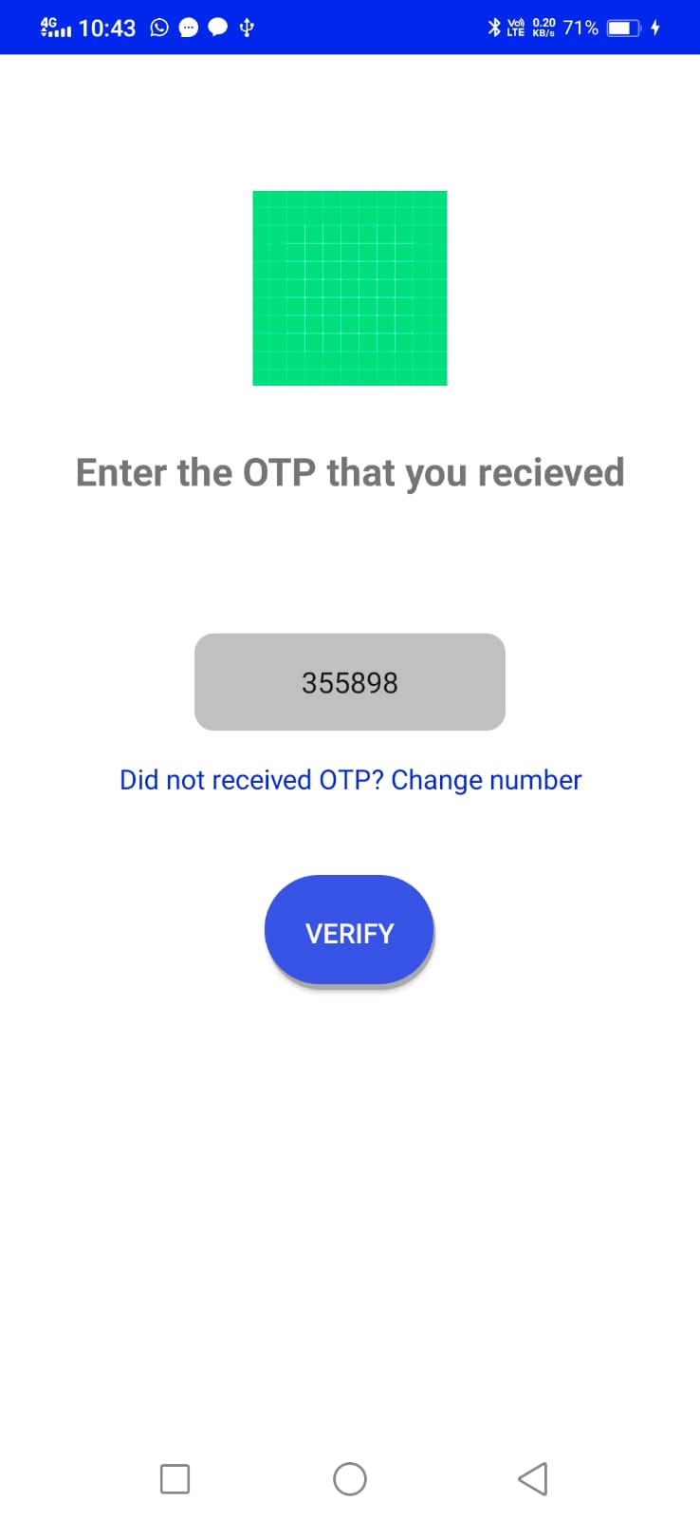
OTP Verification

Slide 12
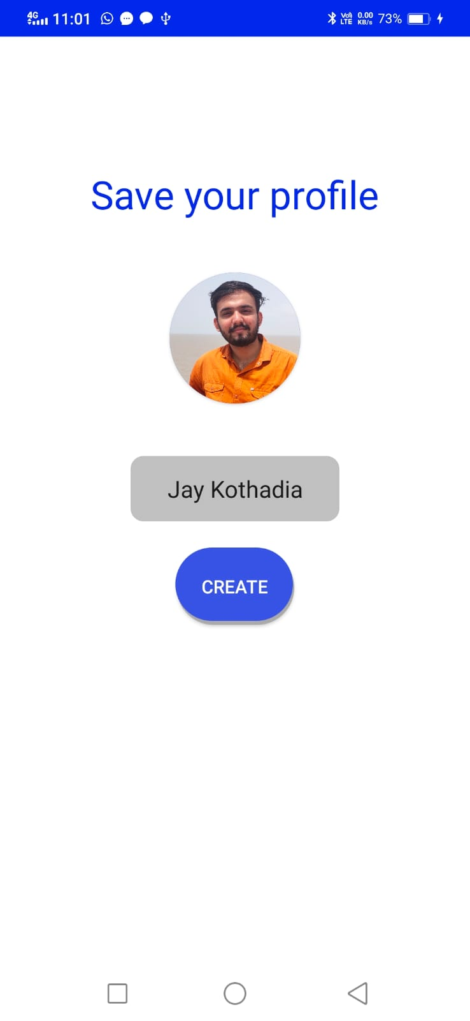
Profile Setup

Slide 13
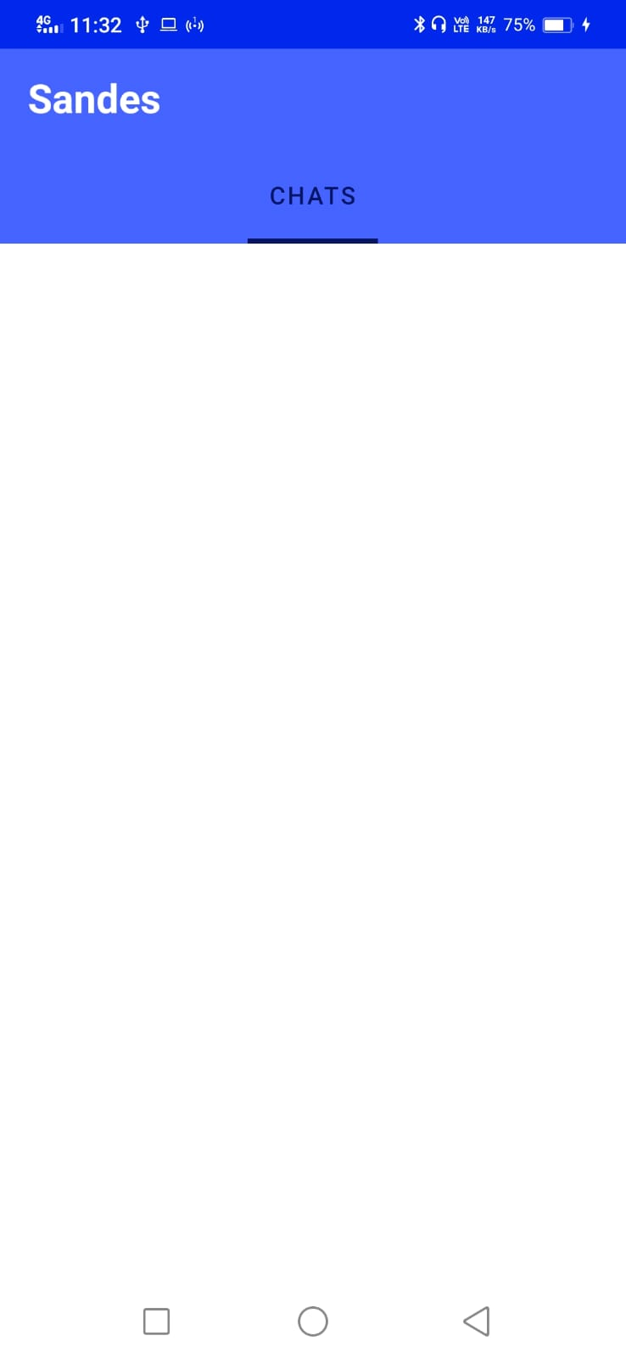
Main Chat Activity (under construction)

Slide 14
Limitation of this App
This application will show all the registered users to the any user.
It will not show list of the users using the app in particular users contact list.

Slide 15
Future Enhancements
We will try to add a feature that will automatically detect the OTP SMS on the user's mobile phone and will auto-fill the OTP.

Slide 16
Thank You

